Slide 1



Cloud Native Workshop
The Cloud Native Platform
Pivotal Cloud Foundry
Notes:
I want to talk to you about cloud native applications, and bringing microservice architectures into production in the enterprise.

Slide 2
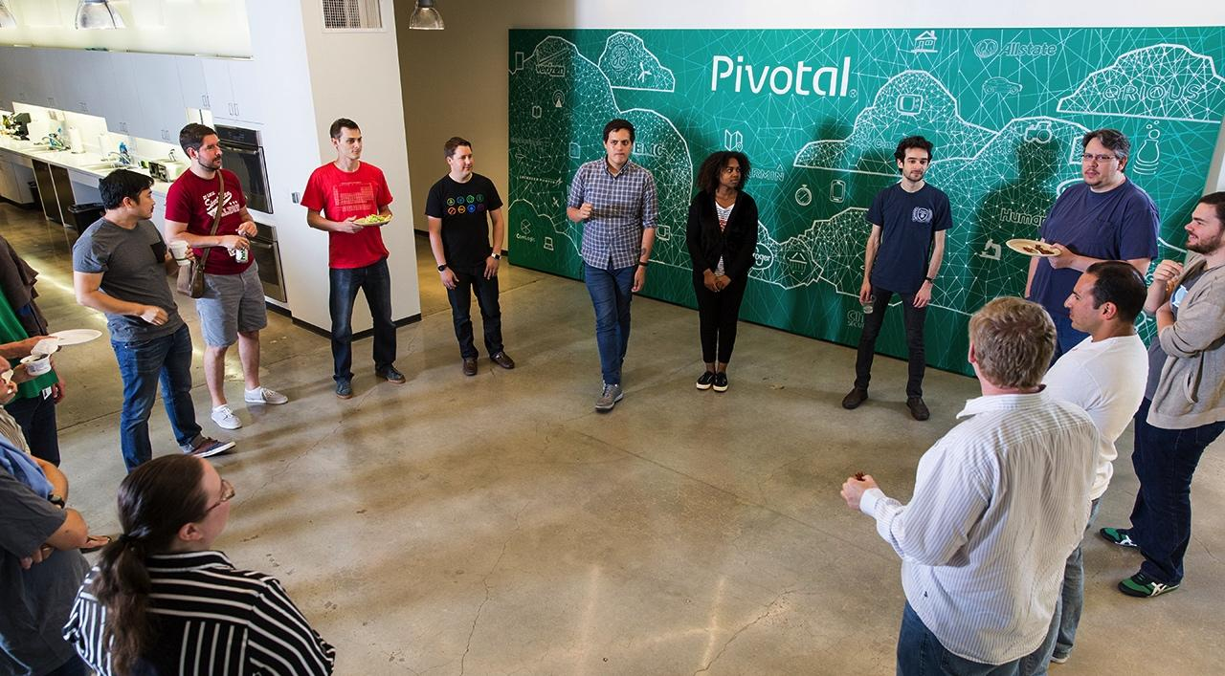

Our mission is to transform how the world builds software

Slide 3
Cloud Native Application Platforms
Business Value, Agility & Cost Savings
Traditional IT
IaaS
Cloud Native
You Manage
Applications
You Manage
Applications
Applications
Data
Data
Data
You Manage
Runtime
Runtime
Runtime
Middleware
Middleware
Middleware
Pivotal CF
+
Choice of IaaS
O/S
O/S
O/S
Virtualization
Virtualization
Virtualization
Servers
Servers
IaaS
Servers
Storage
Storage
Storage
Networking
Networking
Networking

Slide 4
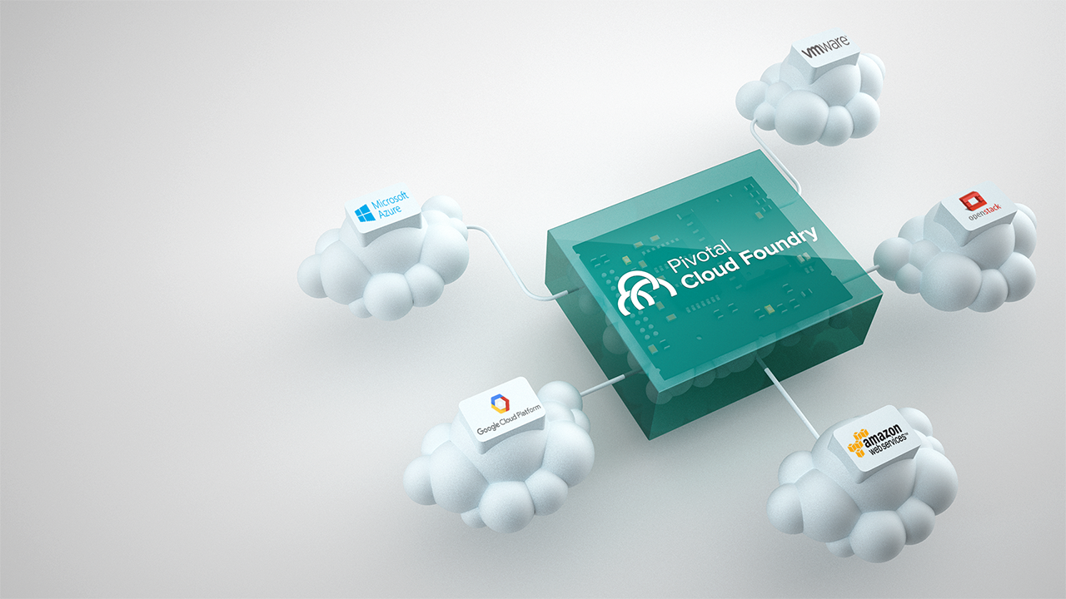
Modern Cloud-Native Platform
Building high-quality software at start-up speed requires modern software methodologies, cloud platform, and data tools

Slide 5
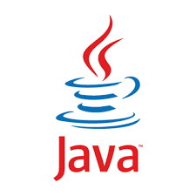
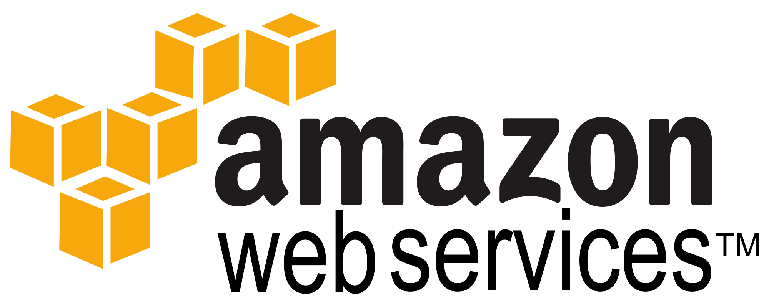
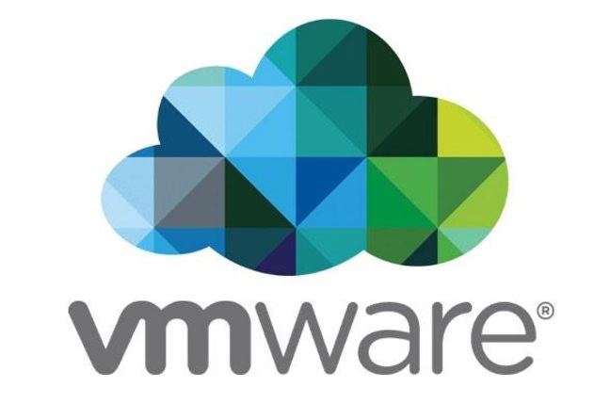


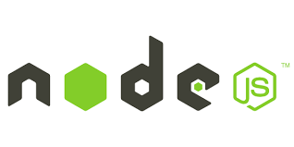
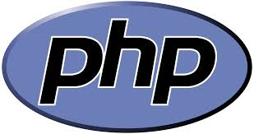
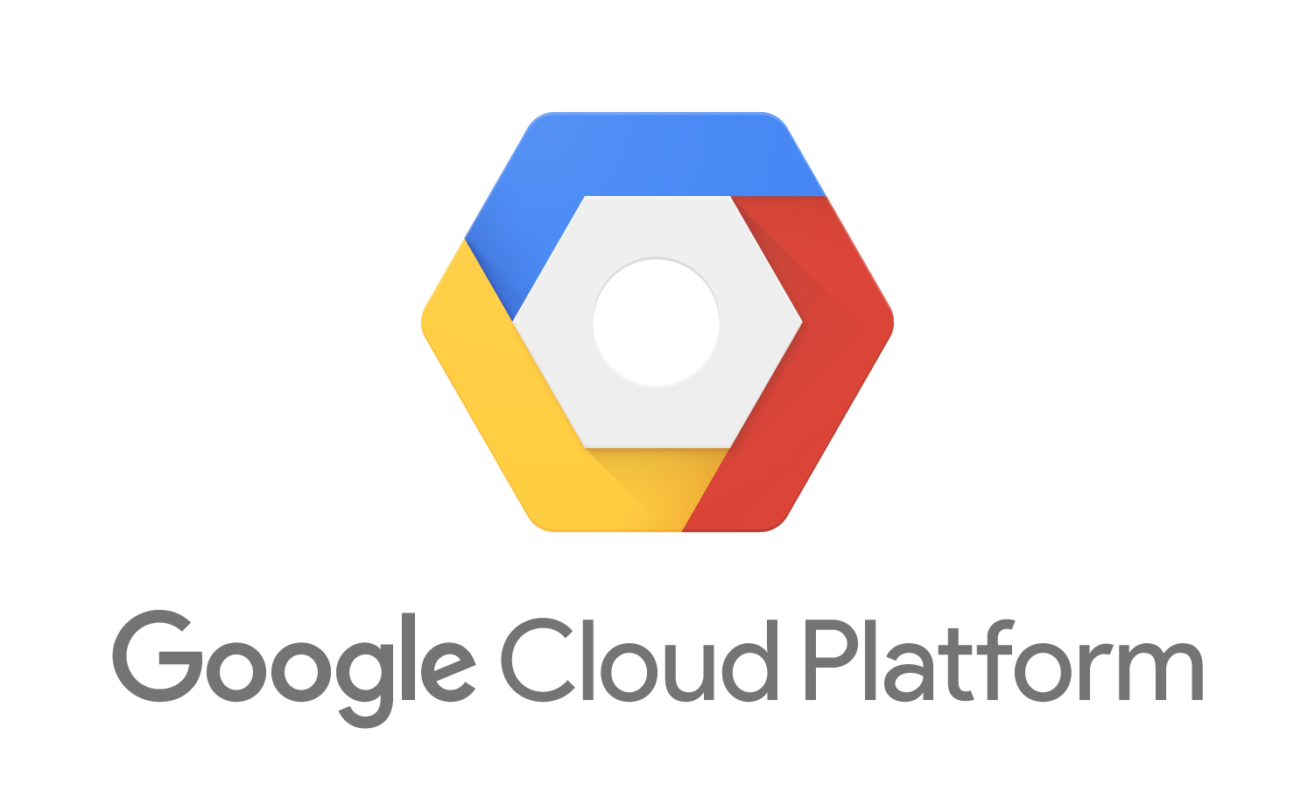


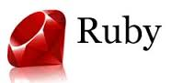
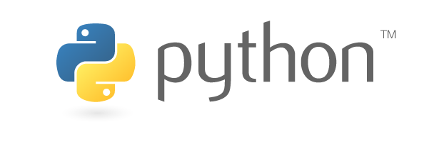
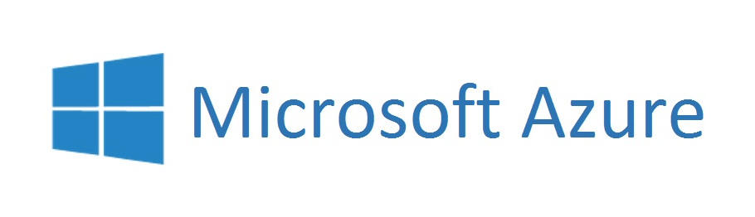

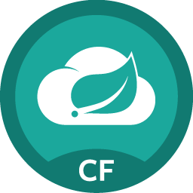
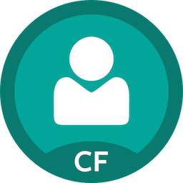
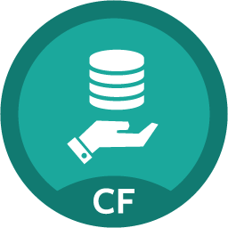
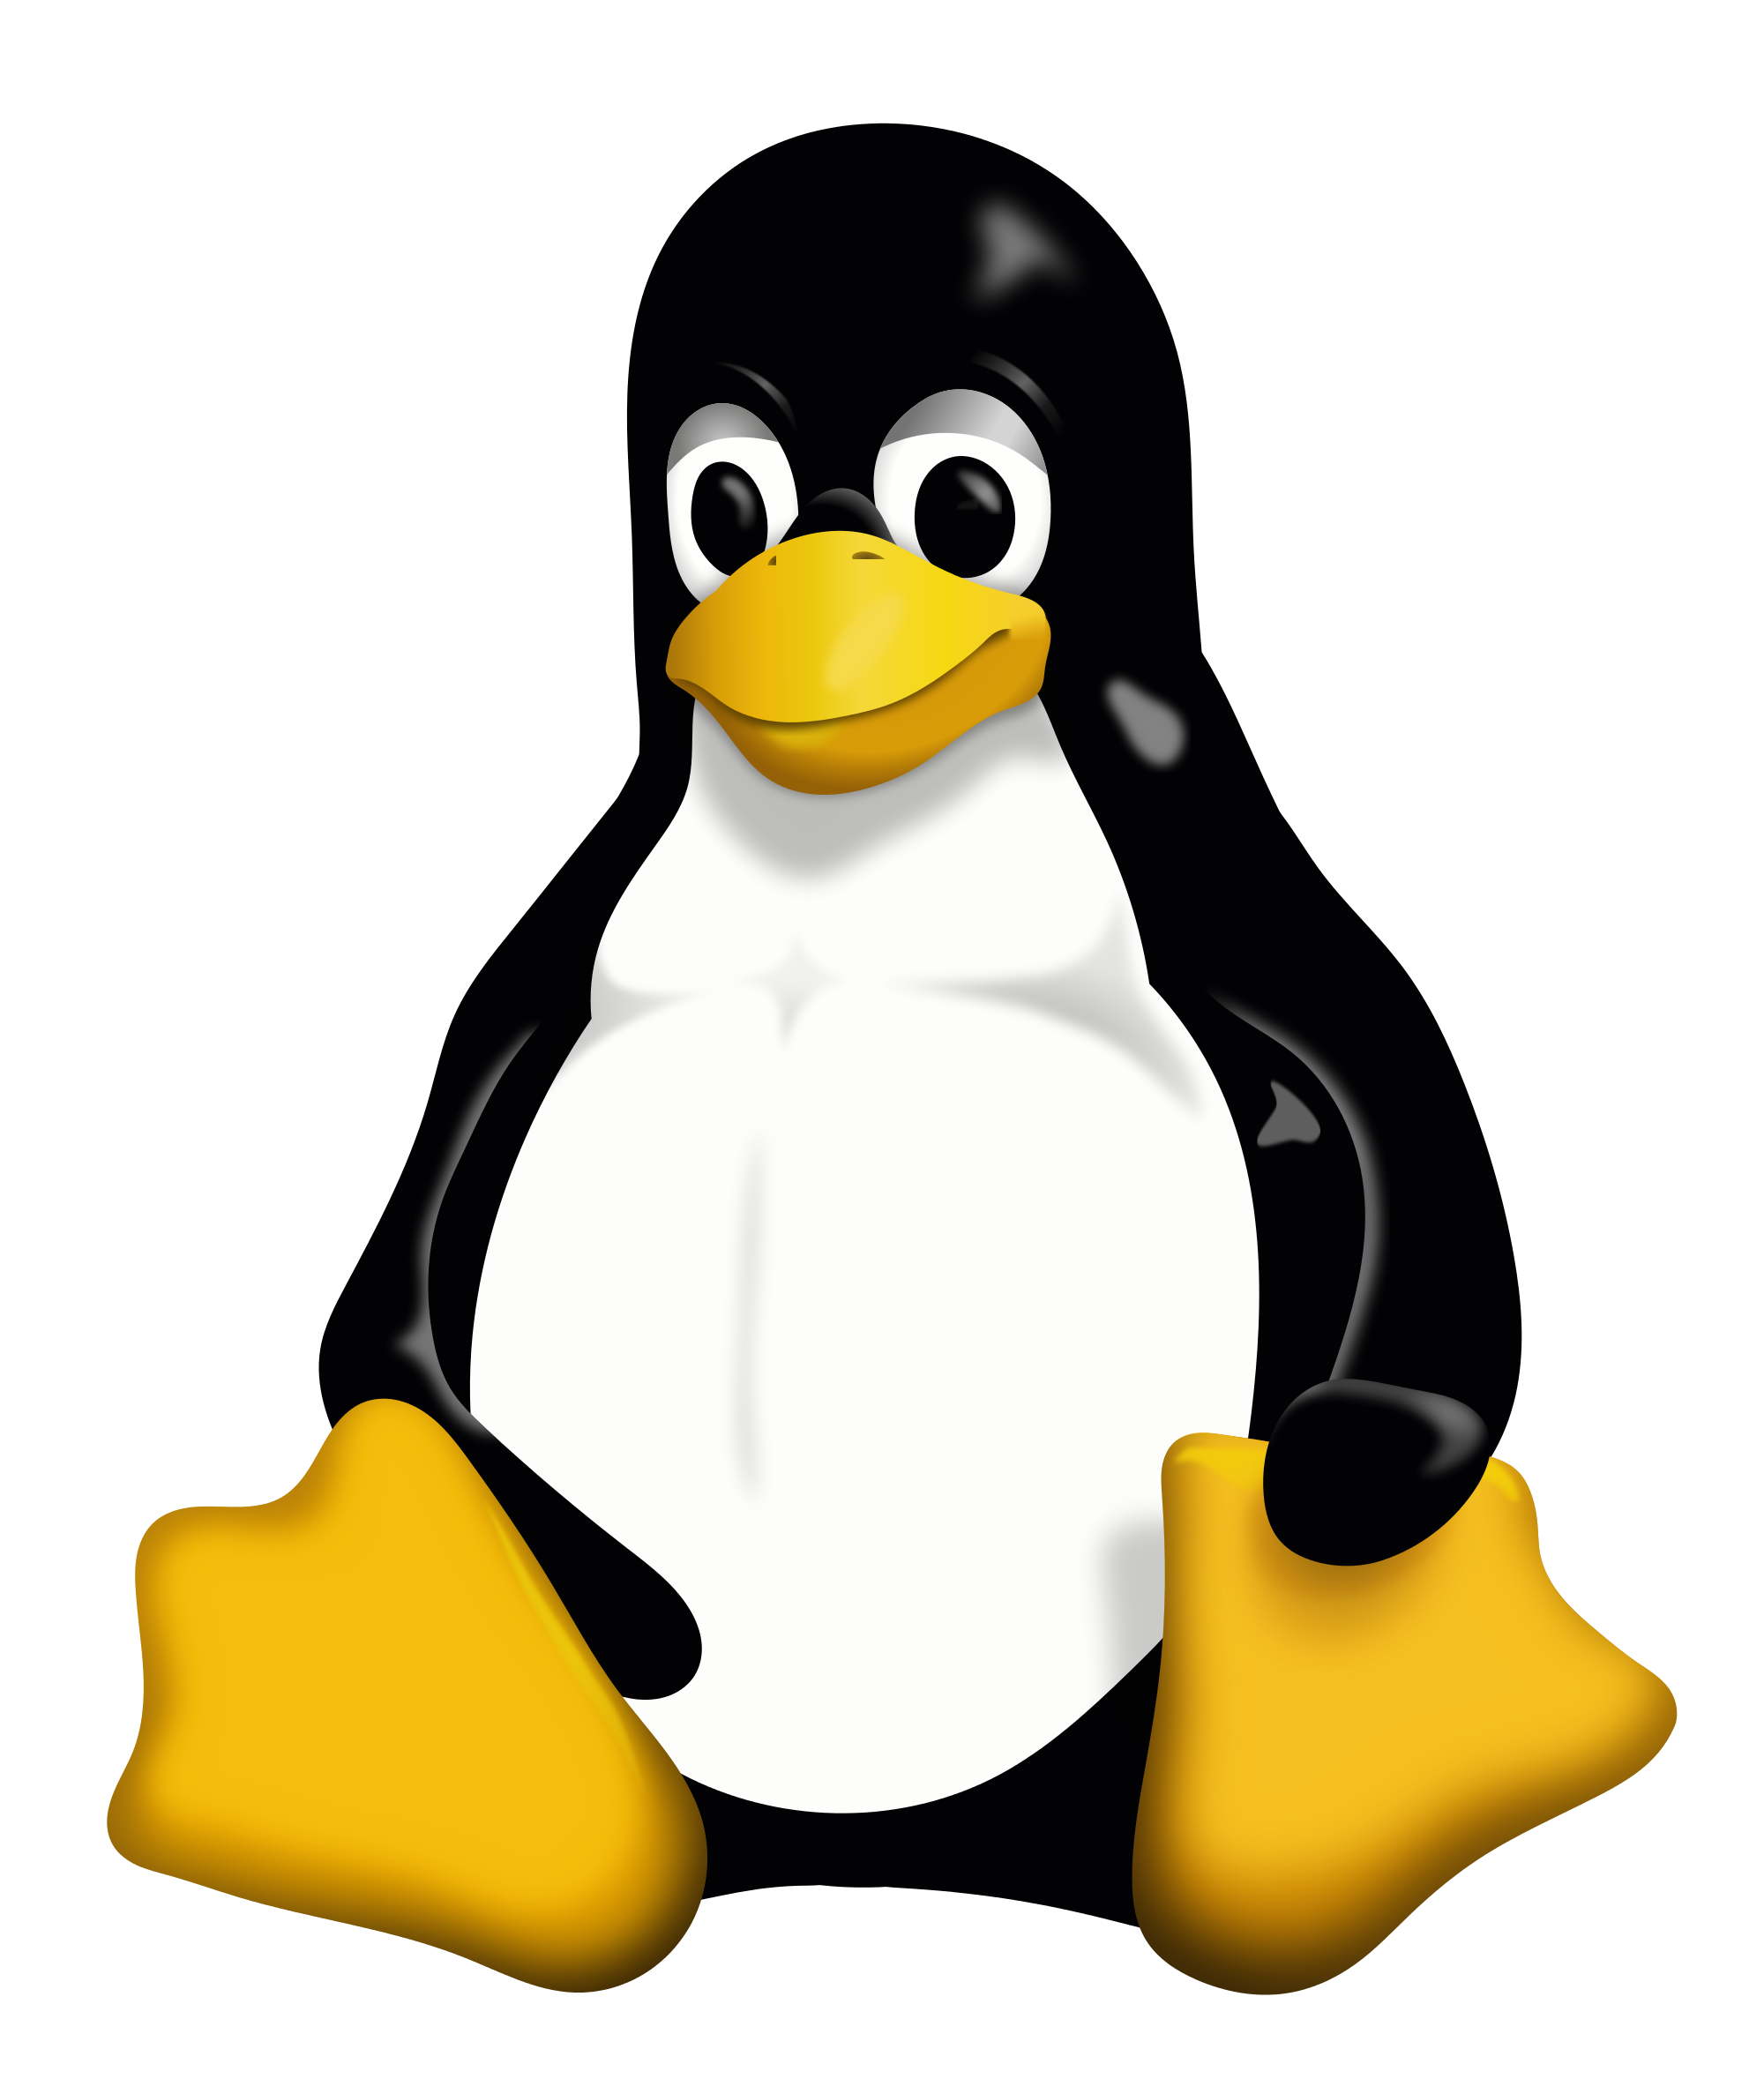

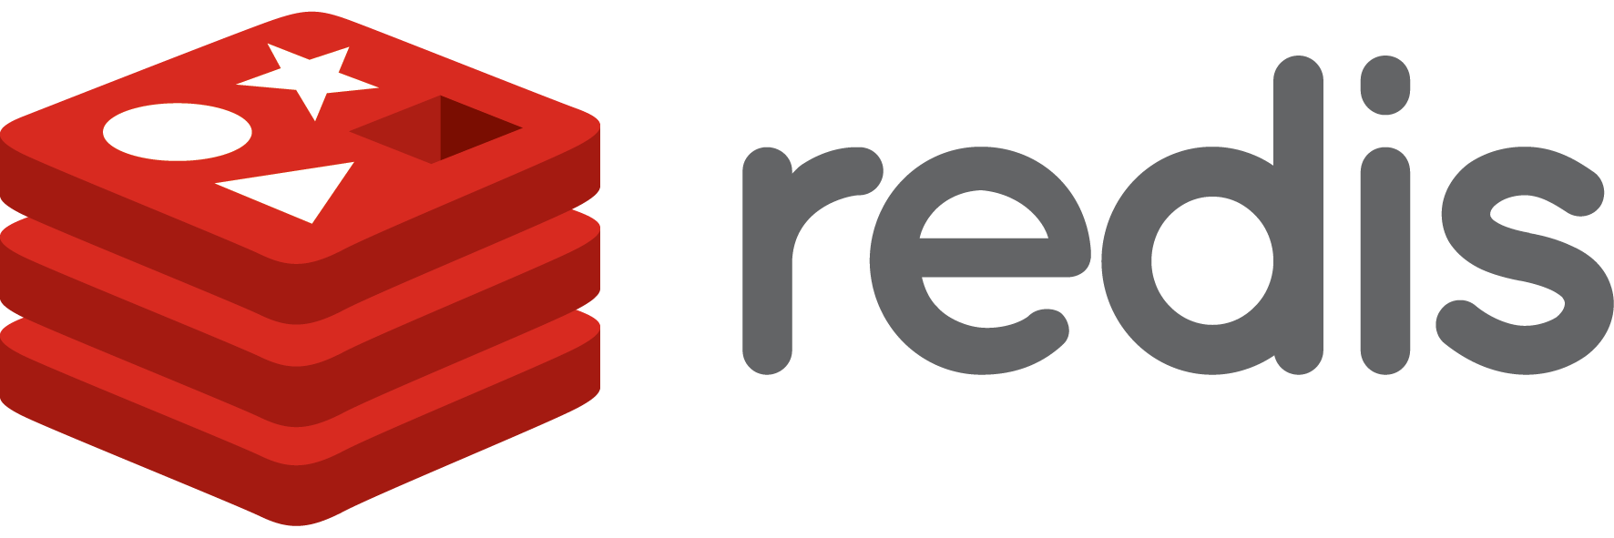

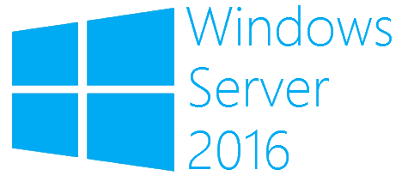
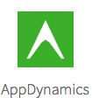
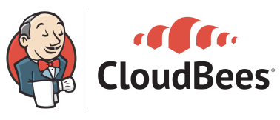
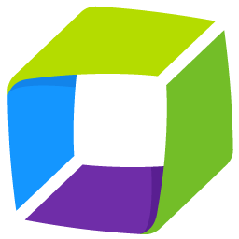
How Pivotal Can Help
Developer Choice
Developer Support
Languages
Clouds
Pivotal Tracker
Metrics, AppDynamics, Dynatrace, New Relic
Language Frameworks & Application Services
Project
Management
Optimize
Code
Apps Manager, CLI, REST APIs, Ops Manager
Language Buildpacks for Staging & Packaging
Manage
Build
Platform Services
OSes
Spring Cloud
Services
Single Sign On
MySQL
Deploy
Provision
Test
API Driven Platform, Concourse, Jenkins
Self-Service and Role-Based Access Control
Dynatrace
AppMon
Container SSH, Loggregator, Metrics
Notes:
HOW PIVOTAL CAN HELP
Before we look specifically at building code, it’s helpful to get a big picture view of all that Pivotal has to offer that can help you be effective in quickly building and delivering applications.
Developer Choice
Pivotal Cloud Foundry provides developers extreme choice in technologies that they choose to leverage in building their applications.
Languages: PCF offers build/deploy automation for many languages including, Java, .Net, PHP, Ruby, Python, node.js and Go. In addition, it is extensible, and can support automated build/package/deploy for other languages, runtimes and frameworks via buildpacks.
Clouds: PCF allows flexibility to run your applications on any cloud infrastructure, whether on-premise (vSphere, Openstack) or with major public cloud vendors (AWS, Azure, Google Cloud Platform). PCF also provides the extensibility to support new and future underlying infrastructures through the Cloud Provider Interface, an infrastructure API layer implemented by the cloud infrastructure provider.
Platform Services: Pivotal has a large and growing collection of developer services that developers can use to build applications rapidly. Services are available from Pivotal as well as its ISV partners. In addition, Pivotal also provides a means to access the large services ecosystems of the major public cloud providers. Finally, Pivotal services ecosystem continues to grow and provide a consistent developer experience thanks to the standardized Cloud Foundry Service Broker abstraction.
OS: Many enterprises currently support mixed linux/windows based workloads. Pivotal Cloud Foundry allows enterprises to run both types of workloads natively on its elastic runtime.
Developer Support
In addition to provide tremendous developer flexibility and choice around key technologies, Pivotal also automates and supports the full spectrum of activities during a software lifecycle.
Project Management: Pivotal provides Pivotal Tracker, the popular agile project management tool, with built in analytics for delivery planning and prediction, and story linking, user feedback and 3rd party integrations, (github, slack, zendesk) to maximize productivity and drive a virtuous feedback loop.
Coding – Pivotal provides the leading application framework (Spring) for Java developers along with .Net/Java access to Spring Cloud Services as well as other highly available developer services for rapid and high quality code development.
Build – Buildpacks provide automation for build, stage, package and deploy workflows in enterprise contexts, that enable not just deployment speed but also deployment consistency and a simplified user experience.
Provision – PCF’s built in quota allocation and provisioning framework allows for efficient self-service access that enables developers to become productive in minutes rather than months when trying to get access to configured compute capacity.
Test – PCF incorporates various tools for debugging and monitoring that can accelerate development by facilitating rapid build-test. Some capabilities that support this include aggregated logs (loggregator). Container SSH to connect securely to a running container, Metrics to monitor application behavior to known test inputs, etc.
Deploy – PCF provides Concourse, a built in CI/CD tool as well as support for Jenkins. Being an API driven platform, these tools can easily use the APIs to orchestrate a CD pipeline to automate testing and deployment.
Manage – PCF provides various means of managing both the platform as well as users and running applications. The platform can be managed by directly calling APIs, or using the CLI or Apps Manager UI (which uses the API) to scale applications, inspect runtime environment configurations and status, etc. In addition, the platform provides Ops Manager to manage the the infrastructure and PCF deployment (using Bosh under the covers).
Optimize – PCF enables metrics gathering and monitoring to enable developers to analyze application behavior in order to fix problems or enhance performance.
Security

Slide 6
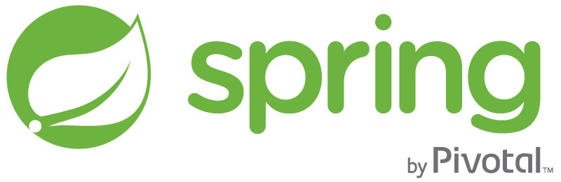


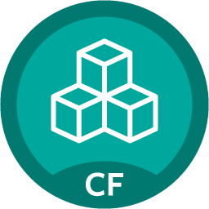

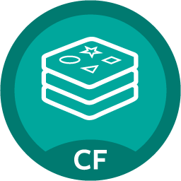
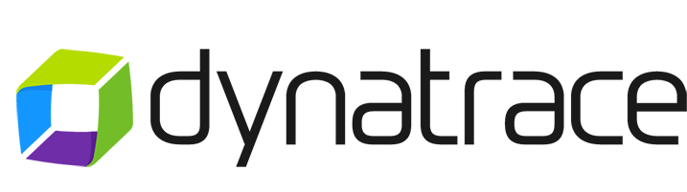
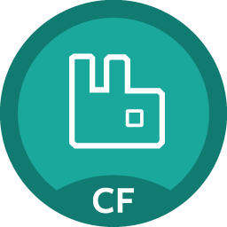



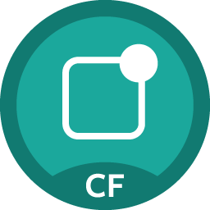
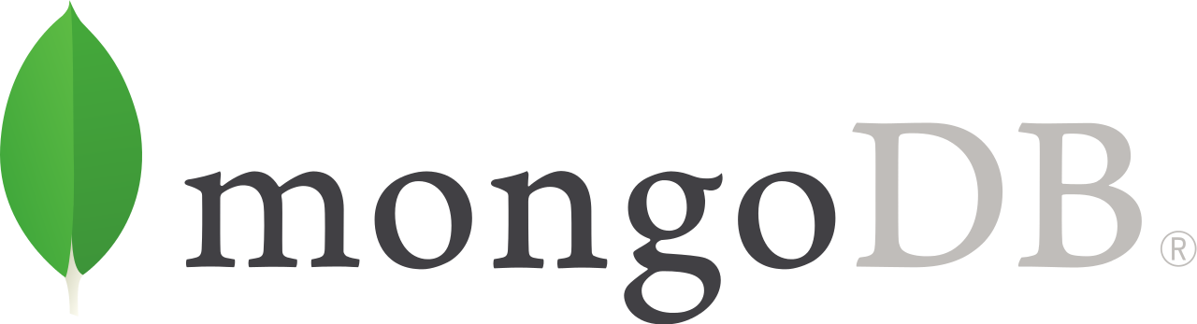
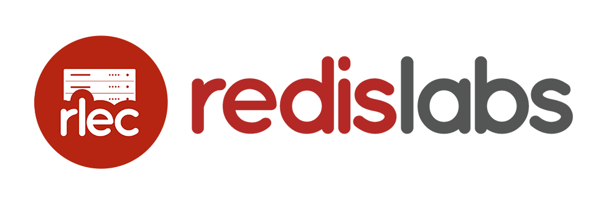

Applications/APIs/Microservices
BOSH Managed
Services
Brokered Services
MySQL
Greenplum DB
Pre-packaged container deployed and managed by platform
PIVOTAL
Compiled, staged, containerized, deployed and managed by platform
Cloud Cache
HDB
Java | .NET | Ruby | Node.js | Python | PHP | Go
…
Redis
PCF Elastic Runtime
PIVOTAL
RabbitMQ
Automated, Polyglot Build/Package/Deploy
Container Scheduling
Elastic (Auto)Scale
Spring Cloud
Services
PCF Tools
Single Sign On
PARTNERED
z
• Apps Manager UI
(App Admin UI)
• CLI
• REST APIs
• PCF Metrics
Dashboard
Integrated Logging/Metrics*
(Application & Platform)
Dynamic Routing & Extensible Route Services
Dev + Ops Role-Based Self-Service Access
Mobile Push Notifications
…
Security
(Application & Platform)
Self-Healing &
High Availability
(Application & Platform)
Zero Downtime Upgrades & Patches
(Application & Platform)
PARTNER
…
Oracle DB
Dingo PostgreSQL
…
MS SQL Server
USER PROVIDED
Infrastructure Automation
(BOSH)
Active MQ
Ops Manager UI
(Cloud Admin UI)
Infrastructure Agnostic Software Packaging
Multi-Cloud Orchestration of Infrastructure Provisioning
IBM DB/2
Distributed Software Configuration and Health/Lifecycle Management
…
Infrastructure
VMware
(vSphere + Photon)
OpenStack
Microsoft
Azure
Google
Cloud Platform
Amazon
Web Services
*Integration with various 3rd party visualization and management vendors
Notes:
Let’s go into a little more detail about the components that actually make up Pivotal Cloud Foundry.
Applications are where things start. You need to select an application framework that lets you build these distributed systems.
We have a platform runtime, which handles routing etc. Attachable backing services for data, CI, and whatever your need
This is built on an operations layer
It does all this on VMware and OpenStack in your data center, plus Amazon public cloud. If each of those infrastructures was an electricity grid, Cloud Foundry would be the travel adapter. You get a single deployment API and set of backing services, so you can port applications with no code changes.
It comes down to this: Would you rather have developers spend their time building a platform, or using one?

Slide 7





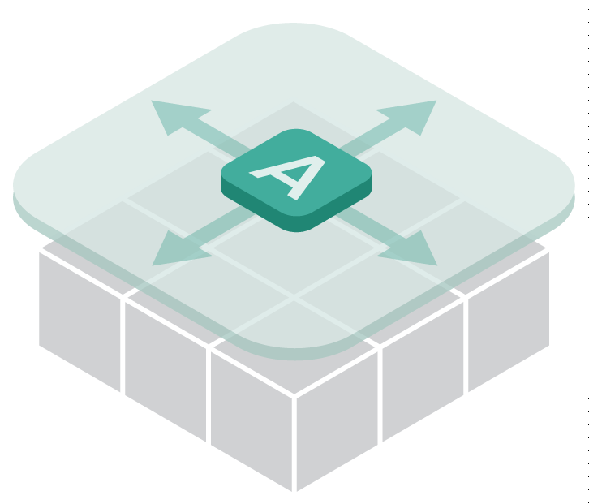

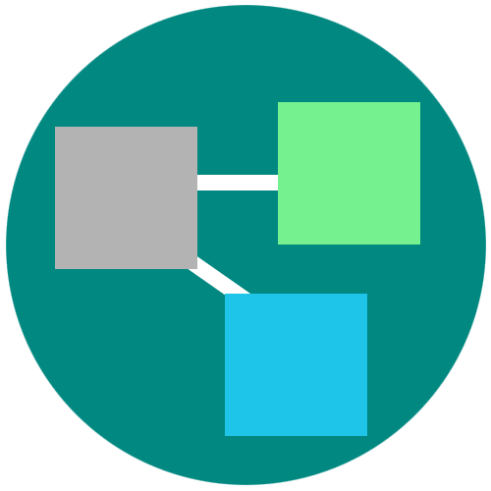
A platform for keeping promises
Roles and Policy
Log aggregation
Security and Isolation
Metrics
Scaling
Health management
Blue green deployment
7
Notes:
Its no longer about running an app on a single VM and relying on Vm centric scaling to manage demand.
PCF provides an abstraction layer that allow you to scale out with application containers as the unit (not the VMs). So…You will no longer need to know which VM or where your app container is running because PCF surfaces visibility at the app layer and not though infrastructure constructs like VMs. We call this an application “dial tone”
This along with a high degree of automation with no additional wiring needed is what radically simplify application operations
You can do really rapid blue-green deployment, A/B testing, health management needed for the resiliency and fast updates of your apps. It has built in features that wrap full lifecycle management like APM, log aggregation. Policy enforcement and role based access to resources are all integrated and can be set.
Everything that you need for an enterprise grade distributed app container management system is right there.

Slide 8
PCF
Architecture

Slide 9







Elastic Runtime Architecture
Automated Platform-as-a-Service
Scalable runtime environment, extensible to most modern frameworks and languages running on Linux
Instant expansion or upgrade with no downtime
Deploy, scale and manage applications with bindable services using simplified semantics and APIs
Pivotal CF Elastic Runtime
Dynamic Router
ROUTING
OAuth 2.0 Server (UAA)
Login Server
AUTHENTICATION
CC & CC Bridge
BBS
Converger
APP LIFECYCLE
BBS/etcd
MESSAGING
Service Brokers
CELL
Blob Store
APP STORAGE
& EXECUTION
Garden
Build Packs
Sys Log
Collector
App Log
METRICS &
LOGGING
Pivotal CF OpsManager/BOSH
Notes:
First, it’s important to understand that the Cloud Foundry Elastic Runtime is, itself, a collection of microservices running on virtual machines. These services govern the health of your containerized applications, provide centralized logging aggregation, automatic scaling and load balancing, etc. Let’s take a look at an example of an inbound HTTP request to our sample application:

Slide 10
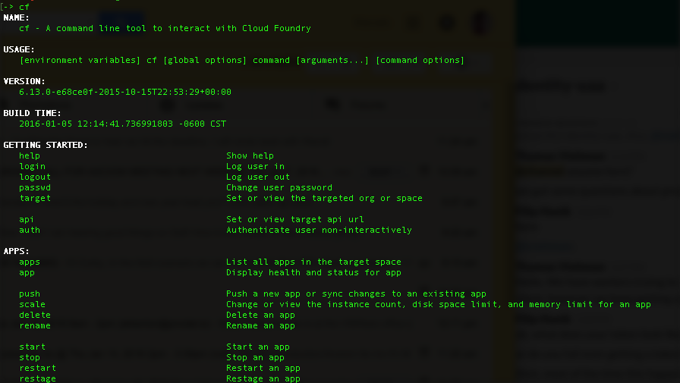
CLI – Command Line Interface
Command line utility providing easy access to the Pivotal CF commands.
Scriptable
Fully documented (cf –help)
Notes:
http://docs.pivotal.io/pivotalcf/console/index.html

Slide 11


Pushing an Application
Blobstore
Service
credentials
Upload app bits and metadata
DB
push app
+ app metadata
Cloud Controller
Service Broker Node(s)
Create and bind services
Stage application
Deploy application
Manage application health
Router
Cloud Controller Bridge
BBS
CELL
Cell
CELL
CELL
+
=
Auctioneer
Notes:
Cloud Foundry PaaS – Pushing an Application with Diego
App deployment: what has changed?
1- Domain specific (notion of apps) -> Abstractions (notions of LRPs and Tasks). App staging is a Task. App start is launching a LRP.
2- Platform specific (linux) -> Supporting multi platform (Windows & Linux) enabling running also .NET apps, thanks to our new Container implementation: Garden
What’s more, there is a 3rd workflow supported: Docker on Linux
3- New Auction-based workload scheduler: Cloud Controller no longer in charge of deciding where AIs are spun up. Auctioneer manages the process running an auction, making it more optimized.
With Diego in place, more loosely-coupled components take part in the process, stripping down the Cloud Controller from too many previous responsibilities, making it easier to maintain and evolve the entire architecture.
The Cloud Controller handles the routing of client requests internally through the Cloud Controller Bridge. It also manages the Blobstore to store packages and droplets and the DB to store App Metadata and Service credentials. Blobstore could be internal or external, depending on the setup.
A service gateway provides an interface for services (native or external).
More in the next slide about the Cloud Controller Bridge (CC-Bridge), the Bulletin Board System (BBS) and the Auctioneer in the next slide
Apps run in a CELL, part of the new Cloud Foundry Runtime, called Diego
Routers manage application traffic.
Diego handles all health management for apps (now LRPs), through a series of single-purpose components: Nsync (part of the CC-Bridge), BBS (part of Diego DB) and the Converger (part of the Diego Brain)
Apps are accessed directly through the router while web and CLI clients (e.g., vmc, STS) access Cloud Controller via RESTful services.

Slide 12
Staging and Buildpacks
Buildpacks are responsible for preparing the machine image for an application.
}
Application
Buildpack
Container
Libraries
Droplet
Cell
Runtime
Operating System
Notes:
bin/detect
The detect script is used to determine whether or not to apply the buildpack to an application.
bin/compile
The compile script builds the droplet that will be run by the Cell and will therefore contain all the components necessary to run the application.
bin/release
The release script provides feedback metadata back to Cloud Foundry indicating how the application should be executed.

Slide 13
Buildpacks
Buildpacks installed into a Cloud Foundry instance or loaded from an external location at app deployment time
Buildpacks provided by public Cloud Foundry
Cloud Foundry Community Buildpack
Write you own
Java
Ruby
Node.js
Go
Python
PHP
Dotnet core
Binary
Staticfile
…
Notes:
Java
Ruby
Node.js
Custom Build packs

Slide 14

Application Staging
Blobstore
DB
Service
credentials
creds
Cloud Controller
Cloud Controller Bridge
Task
Router
CELL
System
Buildpacks
Detect
Compile
Upload
Yes
No
+
=
Elastic
Runtime

Slide 15
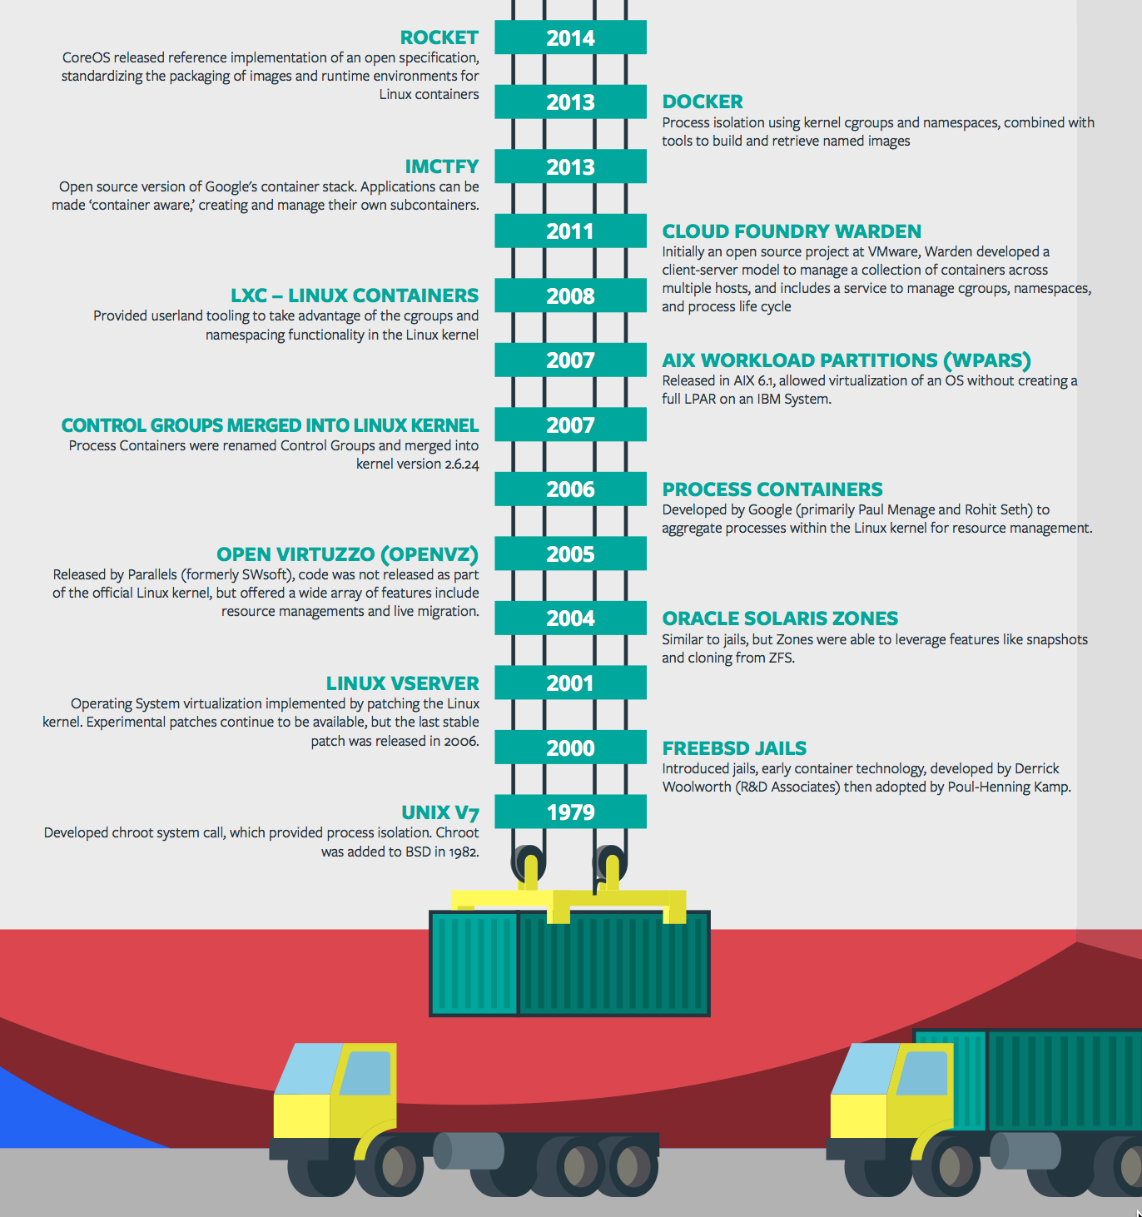
Containers - History
Containers are not new
Cloud Foundry has used containers since it’s inception
Cloud Foundry supports multiple container technologies as first class citizens including Docker, Warden, Garden and runC
Notes:
History of Docker
2006 Google to use containers they built cgroups and namespaces and pushed it to the Linux kernel
cgroups and namespaces give you isolation (Resource Isolation and Namespace isolation)
dotCloud and LXC fragmentation
libcontainer created to address application portability and standard API across linux distros BUT controlled by Docker
Open Container Project (Docker/dockerfile, CoreOS/appc). Standardiized on runC
Standardizing the file format (dockerfile + appc = filesystem)
Standardizing the runtime (libcontainer = runC)
Container (Isolation + Files/metadata + Processes)

Slide 16
Deploying an Application and containers
Cloud Controller
Cloud Controller Bridge
Auctioneer
BBS
Router
ACCESS APP
CELL
CELL
CELL
Rep
Rep
Rep
Executor
Executor
Executor
Notes:
The Cloud Controller passes requests to stage and run applications to the Cloud Controller Bridge (CC-Bridge), and it is no longer in charge of allocating the work.
The CC-Bridge translates app staging and app running requests into Tasks and Long Running Processes(LRPs) respectively, then submits these to the Bulletin Board System (BBS) through an RPC-style API over HTTP.
It is a key component to support Diego’s abstractions and maintain the Cloud Controller API unchanged and handling the same calls from the CLI
Domain specific (notion of apps) -> Abstractions (notions of LPRs and Tasks). App staging is a Task. App start is launching a LRP.
Sub-component responsibility:
The stager takes care of staging requests passing them to the BBS
The nsync takes care of updating the DesiredLPR in the BBS so that new apps can start running.
The CC-Uploader helps at the end of the staging process: Mediates uploads from the Diego Executor to the Cloud Controller Blobstore
The Bulletin Board System (BBS) submits the Tasks and LRPs to the Auctioneer, part of the Diego Brain
Maintains a real-time representation of the state of the Diego cluster, including all desired LRPs, running LRP instances, and in-flight Tasks
The Auctioneer distributes these Tasks and LRPs to Cells through an Auction.
There are two components in Diego that participate in auctions:
The Auctioneer is responsible for holding auctions whenever a LRP needs to be started.
The Rep represents a Diego Cell in the auction by making bids and, if picked as the winner, running the LRPs.
All auctions are held by one Auctioneer with the others standing by as backups in case of failure.
The Auctioneer communicates with Reps on all other Cells when holding an auction.
Only one Auctioneer working at a time. Only one auction can take place at a time.
An Auctioneer initiates an auction when it receives a request to allocate a batch of work (tasks and LRPs) either from:
In response to a request from the Cloud Controller via the CC-Bridge.
The Converger, in response to a mismatch between the desired LRPs and actual LRPs as represented in the BBS.
The Auctioneer queries the state of each Cell via a request to the Cell Rep. The information provided by the Rep includes:
the Cell’s available capacity
the Cell’s stack (windows or linux), important since the Auctioneer checks all cell reps, and it might be trying to run an app compatible only with some cells not all of them.
the set of Actual LRPs currently running on the Cell
Once the Auctioneer assigns a Task or LRP to a Cell, an in-process Executor creates a Garden container in the Cell. The Task or LRP runs in the container.
Thanks to Diego platform agnostic, now these (Garden) Containers can be Linux or Windows. Both implement a generic Garden Interface so that the platform-agnostic Garden can manage either.
Once an App is running in its Container it can be directly accessed through the Router directly into the Cell.

Slide 17
Application scaling
App Ops
Blobstore
Cloud Controller
DB
Service
credentials
creds
Cloud Controller Bridge
Router
BBS
Converger & Auctioneer
Access App
Cell
Cell
Cell
creds
Elastic
Runtime
Notes:
Nsync splits its responsibilities between two independent processes:
The nsync-listener listens for desired app requests and updates/creates the desired LRPs via the BBS.
The nsync-bulker periodically polls CC for all desired apps to ensure the desired state known to Diego is up-to-date.
The BBS also provides a real-time representation of the state of the Diego cluster (including all desired LRPs, running LRP instances, and in-flight Tasks). The Converger periodically analyzes snapshots of this representation and corrects discrepancies, ensuring that Diego is eventually consistent.
Converger
maintains a lock in the BBS to ensure that only one converger performs convergence. This is primarily for performance considerations. Convergence should be idempotent.
uses the converge methods in the runtime-schema/bbs to ensure eventual consistency and fault tolerance for Tasks and LRPs
when converging LRPs, the converger identifies which actions need to take place to bring DesiredLRP state and ActualLRP state into accord. Two actions are possible:
if an instance is missing, a start auction is sent.
if an extra instance is identified, a stop message is sent to the Rep on the Cell hosting the instance.
periodically sends aggregate metrics about DesiredLRPs, ActualLRPs, and Tasks to Doppler.
Rep
represents a Cell and mediates all communication with the BBS by:
ensuring the set of Tasks and ActualLRPs in the BBS is in sync with the containers actually present on the Cell
maintaining the presence of the Cell in the BBS. Should the Cell fail catastrophically, the Converger will automatically move the missing instances to other Cells.
Route-Emitter
monitors DesiredLRP state and ActualLRP state via the BBS. When a change is detected, the Route-Emitter emits route registration/unregistration messages to the router
periodically emits the entire routing table to the router.

Slide 18


D e m o
Pivotal
Cloud Foundry
®
Notes:
Demo 1 – the push and scaling
$ git clone https://github.com/Pivotal-Field-Engineering/pcf-ers-demo.git
$ cd [REPO]
$ ./mvnw clean install
$ cf push
Explain push as it’s happening
$ open http://attendees-${random-word}.cfapps.io
Show application
Show app in Apps Manager
Scale the workshop app to 3 instances
Refresh app display and delete records to show in-memory between instances

Slide 19
Pivotal Cloud Foundry
Multi-tenancy

Slide 20
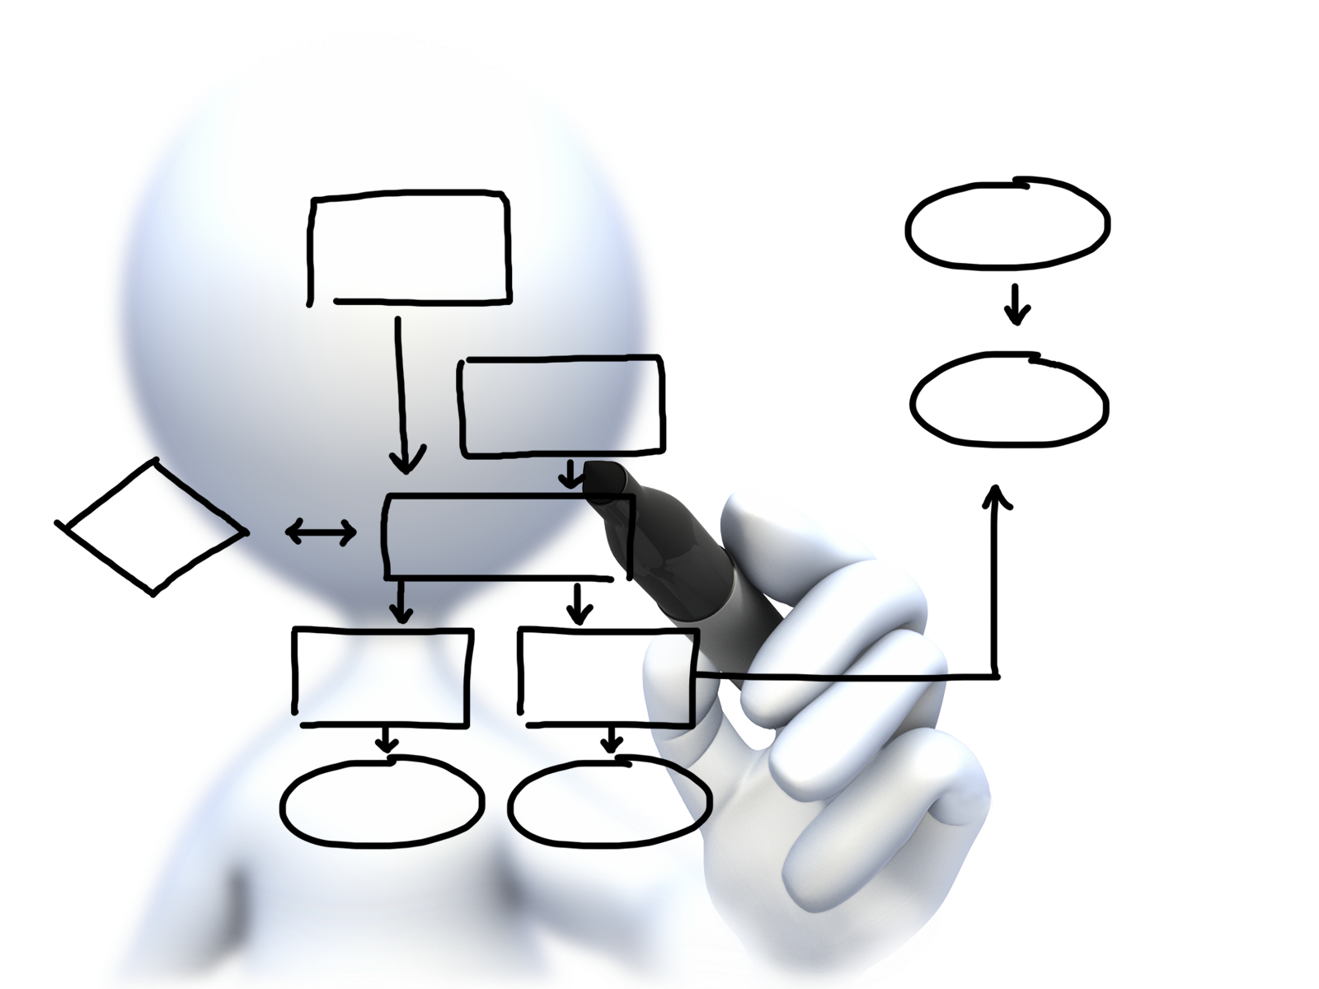
Orgs, Spaces, Users and Quotas
team-org
Quota
Memory
Routes
Users
Art
Spaces
Dev
Services
Apps
Test
Services
Apps
Steve
Chris
Services

Slide 21
Organizations
team-org
Quota
Memory
Routes
Users
Art
Spaces
Dev
Services
Apps
Test
Services
Apps
Steve
Chris
Services
Logical division within a Pivotal CF install / Foundation.
Each organization has its own users and assigned quota
User permissions / roles are specified per space within an organization
Sub-divided into Spaces

Slide 22
Spaces
team-org
Spaces
Dev
Services
Apps
Test
Services
Apps
Prod
Services
Apps
Logical sub-division within an organization
Users authorized at an organization level can have different roles per space
Services and Applications are created / specified per Space
Same Service can have different meanings per space

Slide 23

Quotas and Plans
Different quota limits (e.g. “small”, “enterprise”, “default”, “runaway”) can be assigned per Organization
Quota defines
Total Memory
Total # of Services
Total # of Routes

Slide 24
D e m o
Pivotal
Cloud Foundry
®
Notes:
Demo 2 – multi-tenancy
Show Apps Manager interface
Explain organizations, usage report, and spaces
$ cf org instructor-org to show quota
Show Membership to orgs and spaces
Drill into dev space and explain app and service contents

Slide 25
Pivotal Cloud Foundry
Services

Slide 26
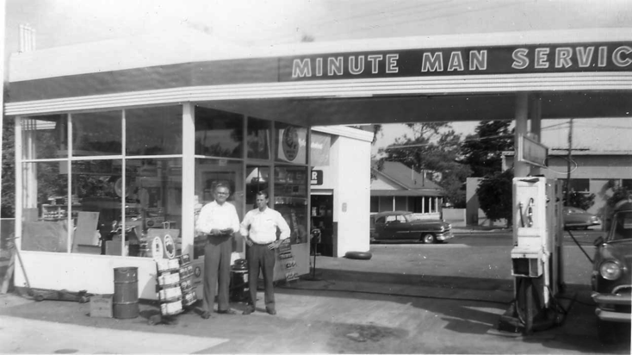
What is a Service
Allows resources to be easily provisioned on-demand
Typically middleware, frameworks, and other “components” necessary for applications
Can be a persistent, stateful layer

Slide 27

Two Types of Services
Managed Fully integrated, with full lifecycle management
User-Provided Created and managed external to the platform

Slide 28
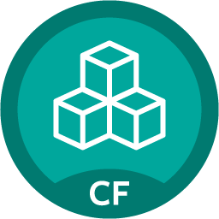
Rapid self-service provisioning
Push button deployed service instance
Bind to apps through easy to use interface
Easy accessibility through Marketplace
Common access control and audit trails across the breadth of services
Marketplace
MySQL
Pivotal Cloud Cache
RabbitMQ
Concourse
Redis
Dynatrace Service Broker
Spring Cloud Services
Google Service Broker
28
Notes:
The integrated approach extends to the Cloud Native Runtime’s integration, with Spring Cloud services being pre-packaged for simple consumption on the platform through our built in marketplace. One leading satellite entertainment provider called this unique blend of microservices supporting features a “no brainer” for their next generation digital services platform. Spring cloud along w/ Spring boot take a developer from idea to a functioning microservice in minutes.
Demo 4 – Environmental elasticity with lazy service binding
Marketplace overview in Pivotal CF App Manager (PCF1) and PWS (run.pivotal.io)
In 4-Prod space, create a new App Autoscaler service called scale-gold
Bind scale-gold service to payments app
In a later demo, the scale-gold service will be used
Demo 5 – Manual & auto -scaling to handle varying workloads
From with Pivotal App Manager console, manually scale payments app to 2 instances
Note number of app instances has scaled to service more users
Manage the scale-gold service to start auto-scaler on the payments app and set the min instances to 3 and max instances to 10.
Within 30 seconds, auto-scaler should increase the payments app instances to 3
Bind each of the following apps to scale-gold: consumer-messaging service, payment-service, and payment-history-service
Manage the scale-gold service and review all apps being managed by the auto-scaler service.

Slide 29
Creating and Binding a Service
Service
credentials
DB
CLI
create service (HTTP)
Cloud Controller
create service (HTTP)
Service
Broker
reserve resources
Data
Service
Router
bind service (HTTP)
bind service (HTTP)
obtain connection data
Elastic
Runtime
Notes:
Cloud Foundry PaaS
An application runs in a Cell. The Cloud Controller orchestrates the routing and lifecycle of all Cells in the pool. Routers manage application traffic. Health Manager reports mismatched application states to the CC. A service gateway provides an interface for services (native or external). A messaging bus manages all system communication. Apps are accessed directly through the router while web and CLI clients (e.g., vmc, STS) access Cloud Controller via RESTful services.

Slide 30
D e m o
Pivotal
Cloud Foundry
®
Notes:
Demo 3 - services
Review PEZ Marketplace
Review PWS Marketplace
Add a workspace-db MySQL service and bind it to the workshop app
Show service credentials
Restart attendees-${random-word} app
Show attendees app, delete a row and show same in all instances

Slide 31
Pivotal Cloud Foundry
Architecture & 4 Layers of High Availability

Slide 32
HA 1 - Failed Application Instances Replaced
App Ops
Desired State
Blobstore
Cloud Controller
DB
Service
credentials
creds
Cloud Controller Bridge
Router
BBS
Converger & Auctioneer
Access App
Cell
Cell
Cell
creds
creds
Elastic
Runtime
Actual State
Notes:
Nsync splits its responsibilities between two independent processes:
The nsync-listener listens for desired app requests and updates/creates the desired LRPs via the BBS.
The nsync-bulker periodically polls CC for all desired apps to ensure the desired state known to Diego is up-to-date.
The BBS also provides a real-time representation of the state of the Diego cluster (including all desired LRPs, running LRP instances, and in-flight Tasks). The Converger periodically analyzes snapshots of this representation and corrects discrepancies, ensuring that Diego is eventually consistent.
Converger
maintains a lock in the BBS to ensure that only one converger performs convergence. This is primarily for performance considerations. Convergence should be idempotent.
uses the converge methods in the runtime-schema/bbs to ensure eventual consistency and fault tolerance for Tasks and LRPs
when converging LRPs, the converger identifies which actions need to take place to bring DesiredLRP state and ActualLRP state into accord. Two actions are possible:
if an instance is missing, a start auction is sent.
if an extra instance is identified, a stop message is sent to the Rep on the Cell hosting the instance.
periodically sends aggregate metrics about DesiredLRPs, ActualLRPs, and Tasks to Doppler.
Rep
represents a Cell and mediates all communication with the BBS by:
ensuring the set of Tasks and ActualLRPs in the BBS is in sync with the containers actually present on the Cell
maintaining the presence of the Cell in the BBS. Should the Cell fail catastrophically, the Converger will automatically move the missing instances to other Cells.
Route-Emitter
monitors DesiredLRP state and ActualLRP state via the BBS. When a change is detected, the Route-Emitter emits route registration/unregistration messages to the router
periodically emits the entire routing table to the router.

Slide 33
HA 2 - Elastic Runtime Processes are Monitored
PaaS Ops
BBS
AGENT
Health Monitor
Responses:
CELL
pager
AGENT
Message Bus
email
monitoring
…
Cloud Controller
AGENT
Pivotal CF Operations Manager
IaaS
Notes:
The processes running on the virtual machines (i.e. the health manager) are started with monit, a nice little utility that keeps an eye on processes and will respond when one dies. If a process dies then, monit will do two things: first, it will try to restart the process and second, whether the restart is successful or not, it will tell the BOSH agent about the failure. Recall that the Bosh agent is there to communicate with Operations Manager and in this case it will relay this failure information to the Operations Manager Health Monitor (not to be confused with the Health Manager of the elastic runtime that was discussed above) – we’ll abbreviate it OMHM. The OMHM will take this alert and pass it through a list of responders that can be configured to do things like send emails, page administrators and display alerts in operations dashboards. There’s a good chance that monit will already have recovered the process, but we also want there to be an opportunity for a human to respond.

Slide 34
HA 2 - Elastic Runtime Processes are Monitored
PaaS Ops
BBS
AGENT
Health Monitor
Responses:
CELL
pager
AGENT
Message Bus
email
monitoring
…
Cloud Controller
AGENT
Pivotal CF Operations Manager
IaaS
Notes:
The processes running on the virtual machines (i.e. the health manager) are started with monit, a nice little utility that keeps an eye on processes and will respond when one dies. If a process dies then, monit will do two things: first, it will try to restart the process and second, whether the restart is successful or not, it will tell the BOSH agent about the failure. Recall that the Bosh agent is there to communicate with Operations Manager and in this case it will relay this failure information to the Operations Manager Health Monitor (not to be confused with the Health Manager of the elastic runtime that was discussed above) – we’ll abbreviate it OMHM. The OMHM will take this alert and pass it through a list of responders that can be configured to do things like send emails, page administrators and display alerts in operations dashboards. There’s a good chance that monit will already have recovered the process, but we also want there to be an opportunity for a human to respond.

Slide 35
HA 2 - Elastic Runtime Processes are Monitored
PaaS Ops
BBS
AGENT
Health Monitor
Restart!
Responses:
CELL
pager
AGENT
Message Bus
email
monitoring
…
Cloud Controller
AGENT
Pivotal CF Operations Manager
IaaS
Notes:
The processes running on the virtual machines (i.e. the health manager) are started with monit, a nice little utility that keeps an eye on processes and will respond when one dies. If a process dies then, monit will do two things: first, it will try to restart the process and second, whether the restart is successful or not, it will tell the BOSH agent about the failure. Recall that the Bosh agent is there to communicate with Operations Manager and in this case it will relay this failure information to the Operations Manager Health Monitor (not to be confused with the Health Manager of the elastic runtime that was discussed above) – we’ll abbreviate it OMHM. The OMHM will take this alert and pass it through a list of responders that can be configured to do things like send emails, page administrators and display alerts in operations dashboards. There’s a good chance that monit will already have recovered the process, but we also want there to be an opportunity for a human to respond.

Slide 36
HA 3 - VMs are Monitored
PaaS Ops
BBS
Desired State
Actual State
AGENT
Health Monitor
BOSH Director
Responses:
CELL
pager
AGENT
Message Bus
email
monitoring
ressurector
Cloud Controller
…
AGENT
Pivotal CF Operations Manager
IaaS
Notes:
Of course, the BOSH agent on a VM can only communicate back to the Operations Manager if the VM is there, so let’s talk about what happens when a VM disappears. First thing to understand is that by “disappear” I mean that the BOSH agent is not functional; the VM could be there, but Ops Manager no longer knows what it is up to so for all intents and purposes it’s “gone”. How does Ops Manager know? One of the things that a BOSH agent is responsible for is sending out heartbeat messages and by default it does so every 60 seconds. The OMHM is constantly listening for those heartbeats and when it finds that one is missing it will itself produce and alert and pass that through the list of responders. Just as described above, this could result in emails, pages and operations dashboard alerts, but in this case there is one more responder that kicks in – the “resurector”. The resurector will communicate with the IaaS over which PCF is running and will ask that the failed VM be replaced. Of course it will be replaced with a VM running the appropriate part of the elastic runtime – i.e. a health manager or Cell, etc. That’s right, Operations Manager will restart failed cluster components.

Slide 37
HA 3 - VMs are Monitored
PaaS Ops
BBS
Desired State
Actual State
AGENT
Health Monitor
BOSH Director
Responses:
CELL
pager
AGENT
Message Bus
email
monitoring
ressurector
Cloud Controller
…
AGENT
Pivotal CF Operations Manager
IaaS
Notes:
Of course, the BOSH agent on a VM can only communicate back to the Operations Manager if the VM is there, so let’s talk about what happens when a VM disappears. First thing to understand is that by “disappear” I mean that the BOSH agent is not functional; the VM could be there, but Ops Manager no longer knows what it is up to so for all intents and purposes it’s “gone”. How does Ops Manager know? One of the things that a BOSH agent is responsible for is sending out heartbeat messages and by default it does so every 60 seconds. The OMHM is constantly listening for those heartbeats and when it finds that one is missing it will itself produce and alert and pass that through the list of responders. Just as described above, this could result in emails, pages and operations dashboard alerts, but in this case there is one more responder that kicks in – the “resurector”. The resurector will communicate with the IaaS over which PCF is running and will ask that the failed VM be replaced. Of course it will be replaced with a VM running the appropriate part of the elastic runtime – i.e. a health manager or Cell, etc. That’s right, Operations Manager will restart failed cluster components.

Slide 38
HA 3 - VMs are Monitored
PaaS Ops
CPI
BBS
Desired State
Actual State
AGENT
Health Monitor
BOSH Director
Responses:
CELL
pager
AGENT
Message Bus
email
monitoring
ressurector
Cloud Controller
…
AGENT
Pivotal CF Operations Manager
IaaS
Notes:
Of course, the BOSH agent on a VM can only communicate back to the Operations Manager if the VM is there, so let’s talk about what happens when a VM disappears. First thing to understand is that by “disappear” I mean that the BOSH agent is not functional; the VM could be there, but Ops Manager no longer knows what it is up to so for all intents and purposes it’s “gone”. How does Ops Manager know? One of the things that a BOSH agent is responsible for is sending out heartbeat messages and by default it does so every 60 seconds. The OMHM is constantly listening for those heartbeats and when it finds that one is missing it will itself produce and alert and pass that through the list of responders. Just as described above, this could result in emails, pages and operations dashboard alerts, but in this case there is one more responder that kicks in – the “resurector”. The resurector will communicate with the IaaS over which PCF is running and will ask that the failed VM be replaced. Of course it will be replaced with a VM running the appropriate part of the elastic runtime – i.e. a health manager or Cell, etc. That’s right, Operations Manager will restart failed cluster components.

Slide 39
HA 4 - Application Instances and Availability Zones
App Ops
Zone 1
Zone 2
Application instances are evenly distributed over two availability zones.
CELL
CELL
Loosing an AZ keeps instances running and available.
CELL
CELL
Router
CELL
CELL
Notes:
Zone could = rack, for example

Slide 40
How Pivotal CF enables four layers of HA
1.
2.
3.
4.
PCF
PCF
PCF
Zone 1
Zone 2
A
B
C
A
B
C
A
B
C
A
B
C
A
B
C
A
B
C
A
B
C
Process
VM1
VM2
VM3
B
B
B
B
3. Resurrector restarts failed VMs
VM1
VM2
B
A
B
C
A
B
C
A
B
C
A
B
C
OS,
Mware
OS,
Mware
OS,
Mware
B
B
B
B
If an app fails, PCF reboots app in a new container.
If a process fails, PCF restarts the process
If an OS or network failure occurs PCF kills the VM and reboots the host in a new Virtual machine.
If a datacenter rack fails, PCF ensures applications stay running in multiple availability zones
App Fail
Process Fail
VM Fail
Rack Fail
Notes:
http://blog.pivotal.io/cloud-foundry-pivotal/products/the-four-levels-of-ha-in-pivotal-cf
Desired State of Application is maintained by Cloud Controller. Cells communicate status of their apps to BBS. BBS checks with Auctioneer. Auctioneer restarts app in another Cell in case of failure
PCF Processes monitored by monit and restarted in case of failure
In case of VM failure. Health Monitor is notified. HM calls BOSH Director which calls Resurrector component which starts up the VM (with processes)
Availability Zones is a logical grouping of the deployment of System Components and Cells. (Example would be two racks in a datacenter)
Application performance and reliability have a direct correlation to HA capability. Pivotal provides 4 level of HA so that you don’t need to invest in people/software to handle common failure situations. If an application fails, we will reboot it in a new container. This automated remediation addresses application bugs that result in outages. If a Pivotal process fails, we will reboot it in a new virtual machine. Our PaaS essentially monitors and remediates itself. If an OS or network failure occurs, our VM monitor will detect this and kill the VM, then reboot it in a new container. This streamlines Linux sysadmin operations. Lastly, if a datacenter rack fails, we will ensure the application stays running because we load application instances in multiple availability zones. No 2 availability zones live on the same datacenter rack. This hardware failure level resilience is very difficult to design using traditional tools provided by HP/CA/IBM.
And, by using Pivotal, you reduce the number of servers that require HP/CA/IBM monitoring tools.

Slide 41
Pivotal Cloud Foundry = Enterprise-grade Platform
Cloud-scale, distributed, self-healing, eventually consistent architecture
Similar patterns in Elastic Runtime (for your apps) and BOSH (for your services)
Declarative – you declare your desired state and Pivotal Cloud Foundry keeps the system consistent with that desired state (4 levels of HA!!)
Zero-downtime, rolling upgrades
Pivotal Cloud Foundry manages containers (ERS) and VMs (BOSH)

Slide 42

Pivotal Cloud Foundry
Auditing and Logging
Notes:
At Pivotal, we believe Transforming how the world builds software will shape the future.
This is our core guiding principle that shapes our product and corporate strategy

Slide 43

Visibility Through Logs and Metrics
Single source for all platform logs and metrics. Single view console that makes system and application monitoring visible and actionable
First packet logging
Enables tool for external audit controls
Aggregated Logging
HTTP Events, Counters, Gauges, Errors
Every stdout and stderr from all apps and platform components
Health gauges
Snap-in best of breed application monitors
AppDynamics, New Relic, Splunk, etc.
Notes:
Application performance monitoring is built into the platform. Pivotal aggregates and streams all system logs, including the load balancer, application, middleware, and operating system. We also log and aggregate application deployment and scale events. You can combine Pivotal with Splunk or use a lower cost log event correlation system because we handle aggregation of multiple log sources. `When it comes to application metrics, we provide a multitude of IT operator data points, including routing counters and VM CPU/RAM health statistics. Each line of business can turn on auto-scaling that will increase/decrease the application instances when average CPU utilization goes up/down.
Lastly, Pivotal recognizes that some vendors can add monitor capabilities above/beyond what we provide. We strongly caution you against using “legacy” platforms like CA and HP, but App Dynamics and New Relic are PaaS aware and work out of the box with Pivotal CF.

Slide 44
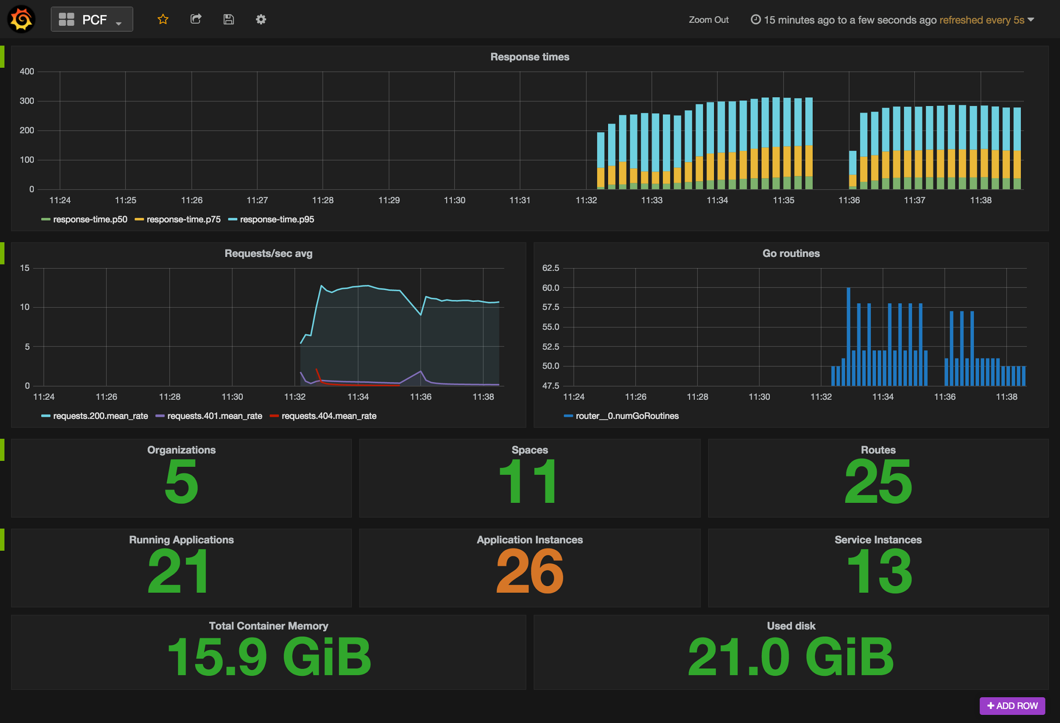
Platform Operations Logging
Platform Operations Logging Firehose
Overall Platform Health
Resource Utilization
Request Volumes / Latency

Slide 45
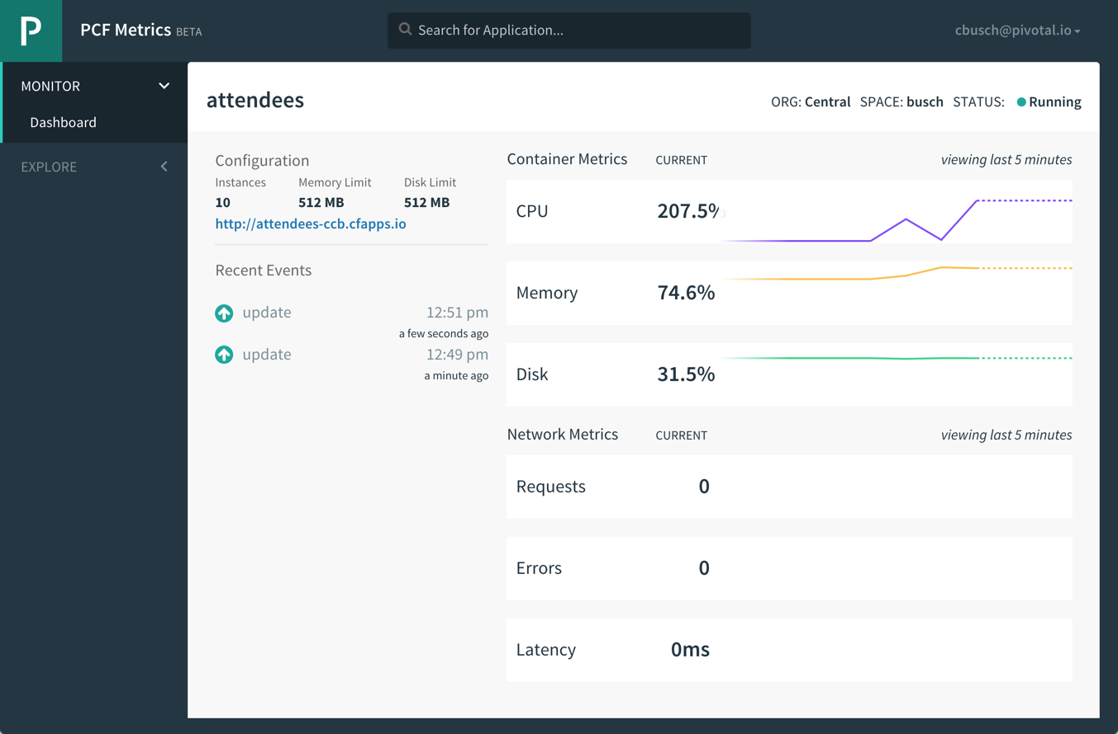
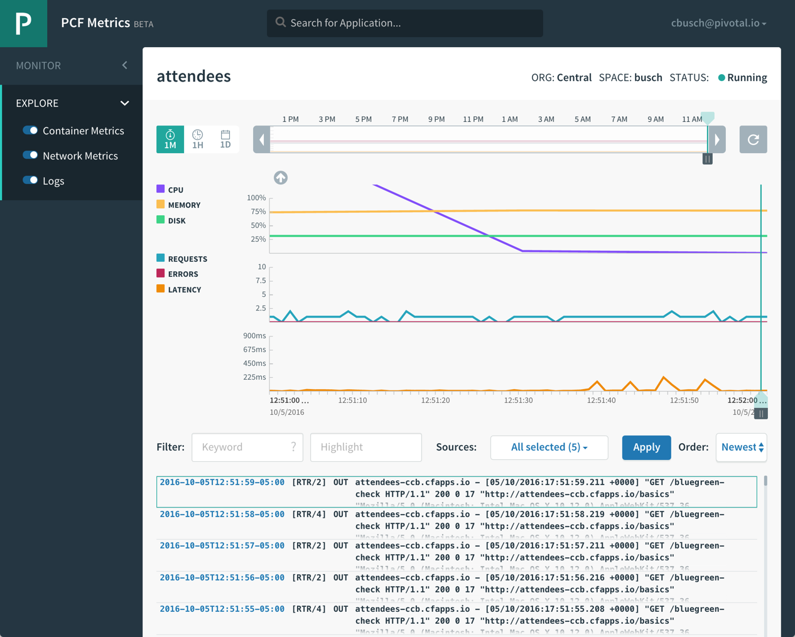
Application Operations Logging & Metrics
Self-service Application Performance dashboards to monitor applications
Per-application container and network metrics with associated log-streams with relevant router activity
Notes:
Show PCF Metrics

Slide 46
D e m o
Pivotal
Cloud Foundry
®
Notes:
Demo 4 – operations and metrics
Ops manager and what it does
PWS Metrics

Slide 47

HANDS-ON LABS
Pivotal
Cloud Foundry
®

Slide 48
Hands-on Lab Instructions
Prerequisites
CF CLI installed
Git installed
git clone https://github.com/cbusch-pivotal/pcf-intro.git
Download zip and unzip
https://github.com/cbusch-pivotal/pcf-intro/archive/master.zip
Lab instructions
https://github.com/cbusch-pivotal/pcf-intro

